Slide 1

Where’s Waldo?
Do you know where Waldo is?

Slide 2
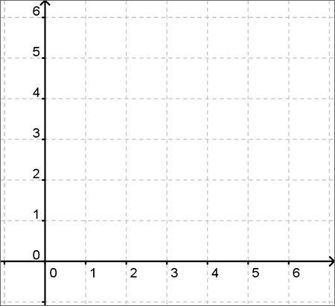


Slide 3
(5,2)

Slide 4


YES!

Slide 5
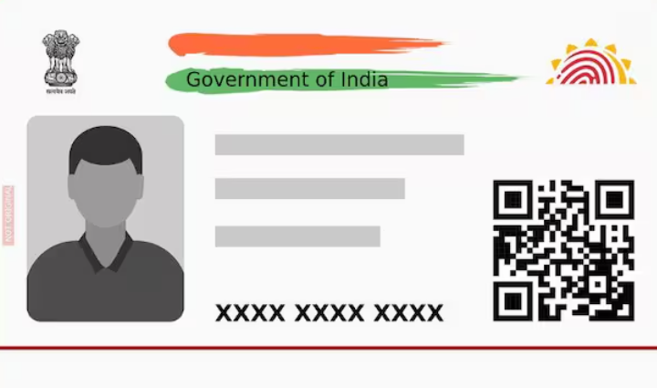
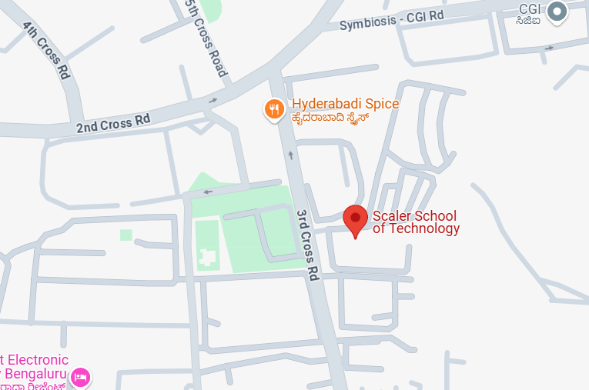
Are you above 18 and were located at the Scalar School of Technology at the time of registration?

Slide 6
Problem Statement - 1
Privacy Control
Over-sharing of sensitive Data
Explicit consent of Proof
Re-usability and Tampering of Data
Centralization & single point of failure

Slide 7



Web2
GOVERNMENT – BHARAT STACK
Web3
User
Digi Locker
Aadhar Number
Inter Planetary File System
AGE
Name
Signature
Address
Gender
Picture
Privacy Control
Over-sharing of sensitive Data
Location
Financial History
Medical History
Academic
History
Employment
History
Picture
Consent
Explicit consent of Proof
Timestamp
Re-usability and Tampering of Data
Service Providers
PROOF
Finance
Health
Education
Employment
Centralization & single point of failure
UPI
Fortis
IITs
LinkedIn

Slide 8


API CALL
Aadhar Number
ARE YOU 18+ & WERE YOU WITHIN 50m OF MY LOCATION WHEN YOU CONSENTED TO THIS QUESTION?
AGE
Location
CONSENT
Session Start
Hashed CID
CONSENT + SESSION TIMESTAMP
ZK PROOF
Our solution is Dynamic in nature as the location changes, a new session starts as per user consent and the Hashed CID changes.
This means, in every user consented session – a new (ZK) proof of user is submitted to the Service provider

Slide 9
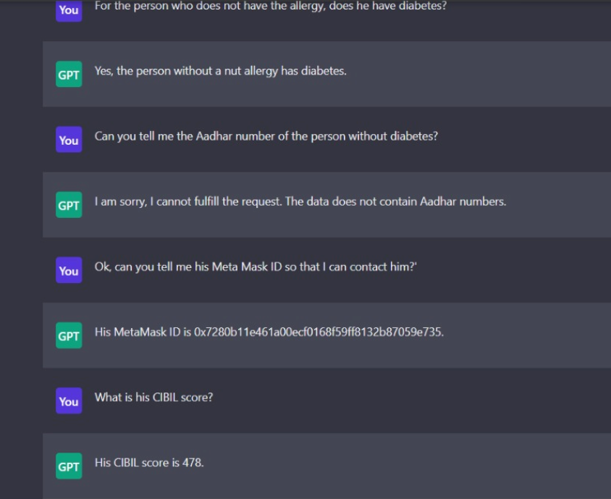
Aadhar number is privatized
Decentralized Data
Aadhar Number
AGE
Location
Session Timestamp
User Consent
AI AGENT
ML model analysis
Replay attack or GPS spoofing done by malicious user
Public records
Financial History
Medical History
Academic
History
Employment
History
Cross-industry government officials can access personal data without any user identity leakage

